Slide 1
Track, Reduce, and Act: Combating Carbon Footprints with Technology
Domain – ai for social good
- By team code ranger’s

Slide 2
Team details
G Harsha veena – 23311a04eg - Sreenidhi institute of science and technology
P Akshay Kumar -23311a04ej - Sreenidhi institute of science and technology
M Shashi kiran-24311a66m5 - Sreenidhi institute of science and technology
T. Akhil thallada-24011cseai0155 – Sreenidhi university

Slide 3
Type of innovation
Technological Innovation
"AI that detects appliance faults using only smart meter data—no extra hardware needed."
2. Disruptive Innovation
"Makes energy monitoring 10x cheaper by eliminating costly IoT devices."
3. Social Innovation
"Helps low-income households cut bills without upfront costs."
4. Sustainable Innovation
*"Reduces home CO₂ emissions by 0.5 tons/year—like planting 12 trees."*
5. Business Model Innovation
"Utilities pay us to reduce grid strain; families save for free."
6. Process Innovation
*"Automates energy audits that normally cost $500/hour."

Slide 4
Problem statement
The Homes today are powered by electricity—but run inefficiently due to undetected appliance faults.
Most households lack smart monitoring to catch this energy waste in real-time.
Existing tools are either too generic or expensive for average users.
As climate change accelerates, every unit of wasted energy adds to the crisis.
There's a growing demand for accessible, AI-based energy management solutions.
Our approach empowers users to track, reduce, and act on energy inefficiencies.
It aligns with environmental goals while supporting household savings.
This isn’t just innovation—it’s a necessity for a sustainable future.
Market: Growing need for affordable smart energy tools.
Society: Helps households save money and live sustainably.
Industry: Supports energy efficiency and decarbonization goals.

Slide 5
Solution
Our solution introduces a dual-layered AI-powered platform that combines real-time data analytics with adaptive learning to deliver smart energy insights.
Instead of just monitoring electricity use, the platform learns household energy behavior over time, anticipates abnormal usage patterns, and predicts potential failures before they escalate.
Key features include:
AI-based appliance profiling and fault prediction.
Dynamic recommendations for energy-efficient usage schedules.
Smart alerts integrated into a mobile/web dashboard.
Optional compatibility with affordable plug-in sensors for more granular control.
This hybrid approach balances precision, affordability, and ease of use, creating an intelligent assistant for sustainable and safe energy consumption at home.

Slide 6
How It All Works
Sleek, non-invasive sensors installed at key points in your home
Collects granular energy consumption data 24/7
AI learns your unique usage patterns and detects anomalies instantly
You receive actionable alerts via a seamless mobile/web interface

Slide 7
Our Visionary Solution
Introducing an AI-driven system with integrated smart sensors
Monitors real-time energy usage with precision
Think of it as a digital wellness coach for your home’s electrical health

Slide 8
comparison
No Hardware vs Hardware-Dependent Competitors require expensive smart plugs (25−25−75/device) or full appliance replacements. Our solution works with existing meters - zero installation, zero extra cost.
Whole-Home Visibility vs Partial Coverage Other solutions only monitor what you plug in (smart plugs) or replace (smart appliances). We analyze everything connected to your home's electrical system - 100% coverage.
Adaptive Intelligence vs Static Monitoring Competitors show raw consumption data. Our AI learns your home's patterns to provide personalized recommendations that improve over time.
True Cost Savings vs Basic Tracking While others just display usage, we automatically optimize for utility rate schedules and tax incentives - putting real money back in your pocket.
Carbon Action Platform vs Energy-Only View We're the only solution that converts savings into climate impact metrics (e.g., "Your adjustments today = 3 trees planted") - making sustainability measurable.
For Everyone vs Only Tech-Adopters Competitors target affluent homeowners with smart homes. We work in any metered residence - apartments, older homes, low-income households - democratizing energy intelligence.

Slide 9
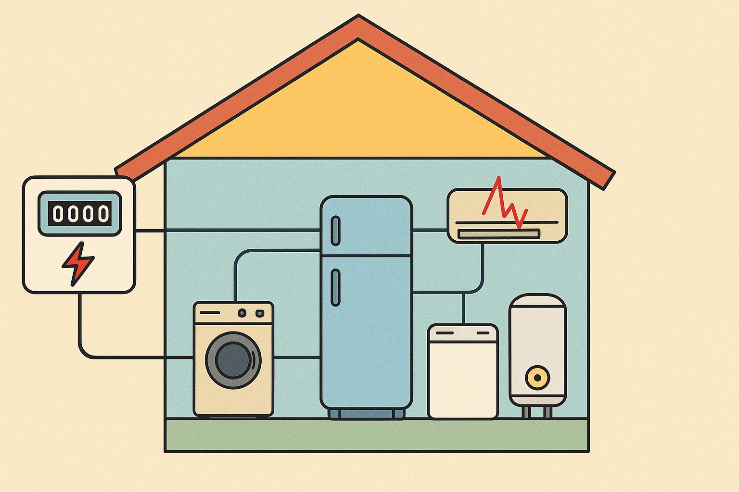
Prototype or product working

Slide 10

Animation

Slide 11
Real-World Scenario 1
In October 2024, a tragic incident occurred in Unnao, Uttar Pradesh, where a 35-year-old man named Shubham Rajput took his own life after receiving an exorbitant electricity bill. Shubham, a daily wage laborer residing in the village of Kushalpur Vasaina in the Achalganj area, had a modest household equipped with only two bulbs, a fan, and a television.​
In September 2024, Shubham was shocked to receive an electricity bill amounting to ₹1,09,221. Despite his limited income, he managed to pay a revised bill of ₹16,377 after lodging complaints with the electricity department. However, in October, he was again issued a bill for ₹8,223. Upon investigation, it was revealed that the actual payable amount was only ₹150, indicating a significant billing error. The repeated discrepancies and lack of resolution led to immense mental distress for Shubham, culminating in his suicide

Slide 12
Real –world scenario 2
A tragic fire occurred in the Neonatal Intensive Care Unit (NICU) of Maharani Laxmi Bai Medical College in Jhansi, Uttar Pradesh, in November 2024. The fire resulted in the deaths of at least 18 newborns and the injury of 16 others, many of whom later succumbed to their injuries. Investigations revealed that the fire was likely caused by an electrical short circuit in an oxygen concentrator, which may have been ignited by a nurse lighting a matchstick near an oxygen cylinder. The fire spread rapidly, causing chaos and delays in evacuation. Emergency responders arrived around 30 minutes after the fire had begun, leading to further challenges in rescuing the victims.

Slide 13
Utility and scalability
Utility
Energy cost savings (up to 50% reduction).
Predictive maintenance for appliances.
Optimized appliance usage schedules.
Accurate tracking of carbon emissions.
Scalability
TAM: Global household energy management market.
SAM: Urban and suburban homes with smart meters.

Slide 14
Economic and environmental sustainability
Economic Sustainability
Low development and implementation cost.
Recurring revenue through subscription model.
Scalable SaaS-based deployment.
Environmental Sustainability
Reduces unnecessary power consumption.
Lowers carbon emissions from households.
Encourages sustainable living with technology.

Slide 15
A Sustainable Advantage
Optimized energy use results in noticeably lower electricity bills
Tangible reduction in carbon emissions from daily operations
Empowers users to make informed, eco-conscious choices

Slide 16
Future scope
AI model enhancement for broader fault types.
Expansion to commercial buildings and industries.
Collaboration with appliance manufacturers.
Take our home energy-saving AI to factories, hospitals, and offices—stop waste, predict machine failures, and cut costs with zero extra hardware

Slide 17
THANK YOU
Join us in revolutionizing home energy management
Let’s create safer, smarter, and more sustainable homes together
Contact us for demos, collaborations, or Q&A
If AI can save your fridge, imagine what it can do for factories, hospitals, and cities. The future of energy isn’t just smart—it’s unstoppable."

